Slide 1
Internship Overview
-Vishakha Sawant

Slide 2
Tasks Summary:-WebReports
Sparcade
SQLIDE
Tripeaks
Platform Specific Reports-Mobile

Slide 3
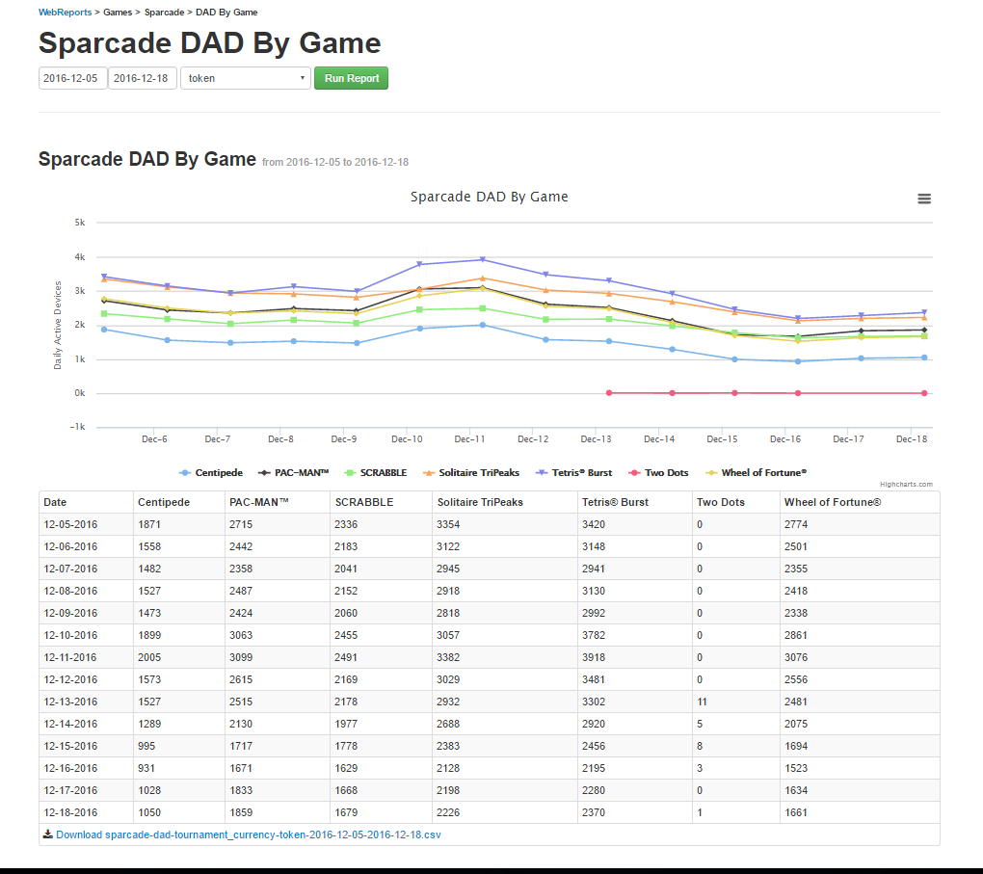
Sparcade:-

Slide 4
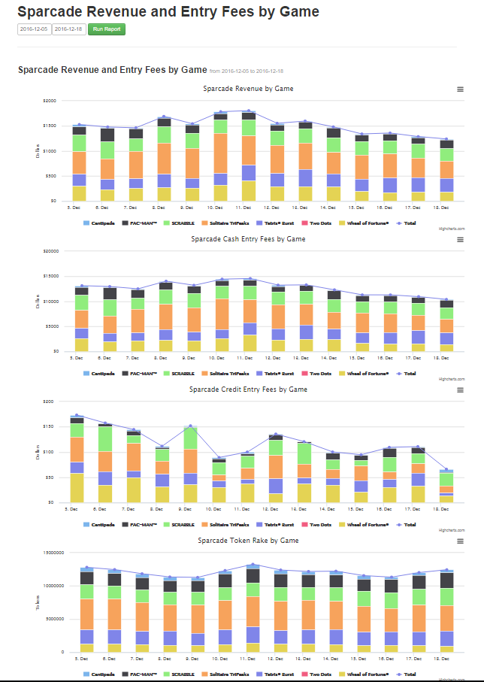

Slide 5
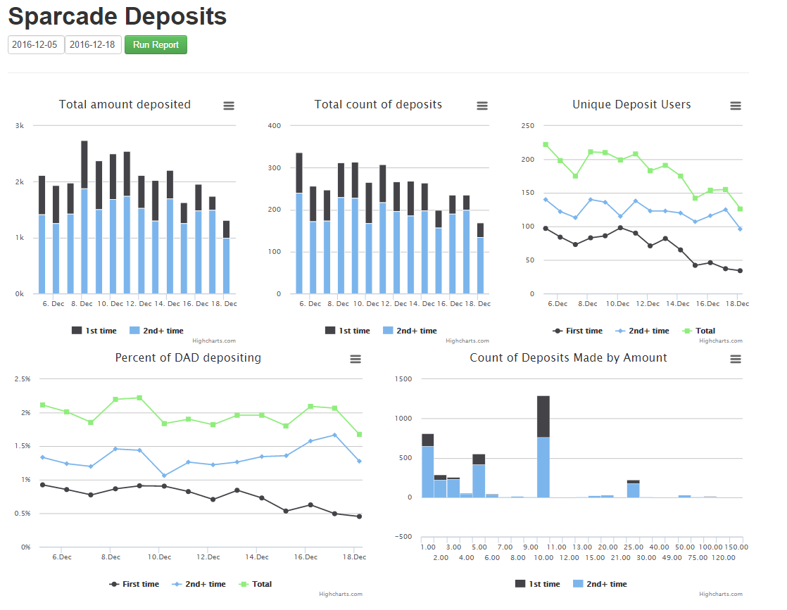

Slide 6
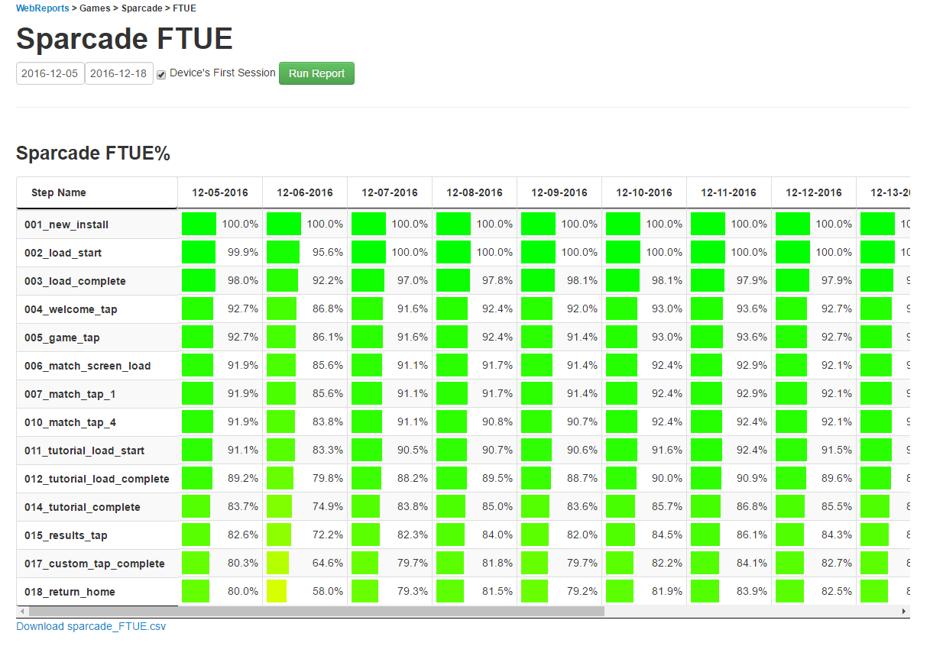

Slide 7
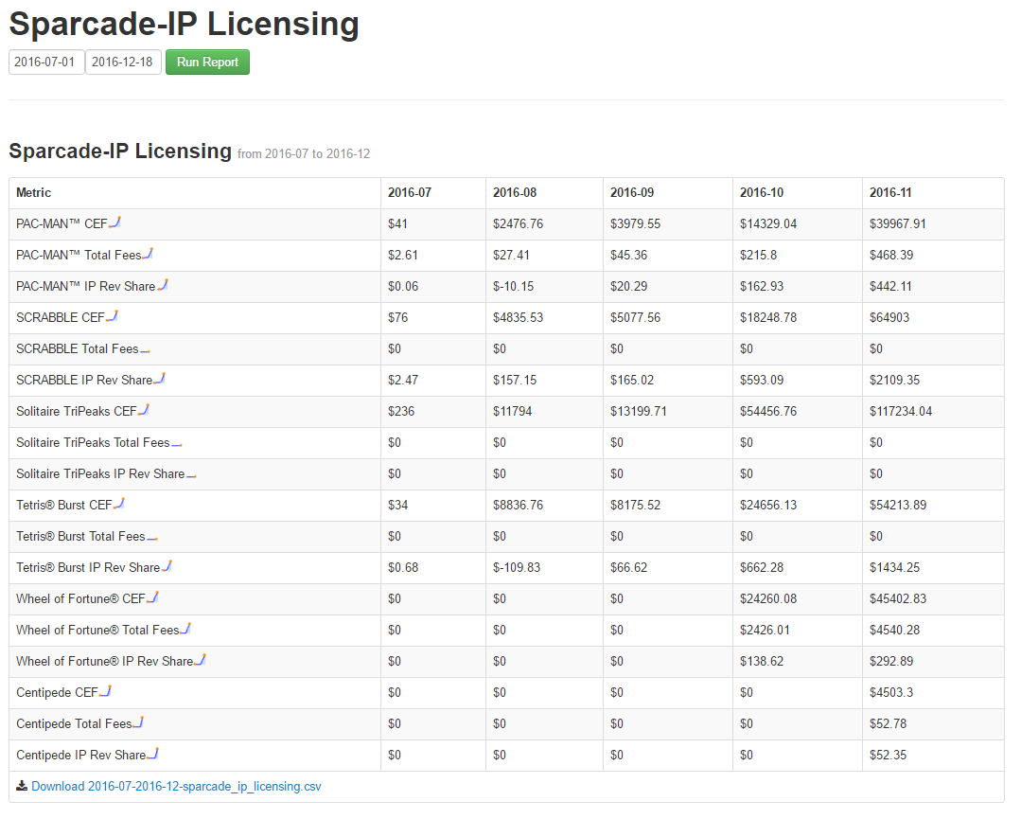

Slide 8
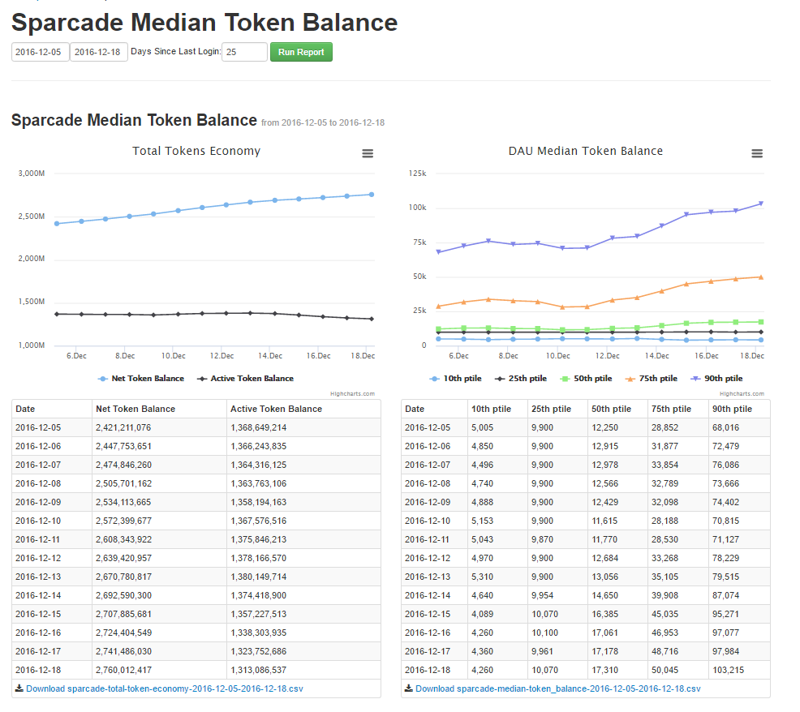

Slide 9
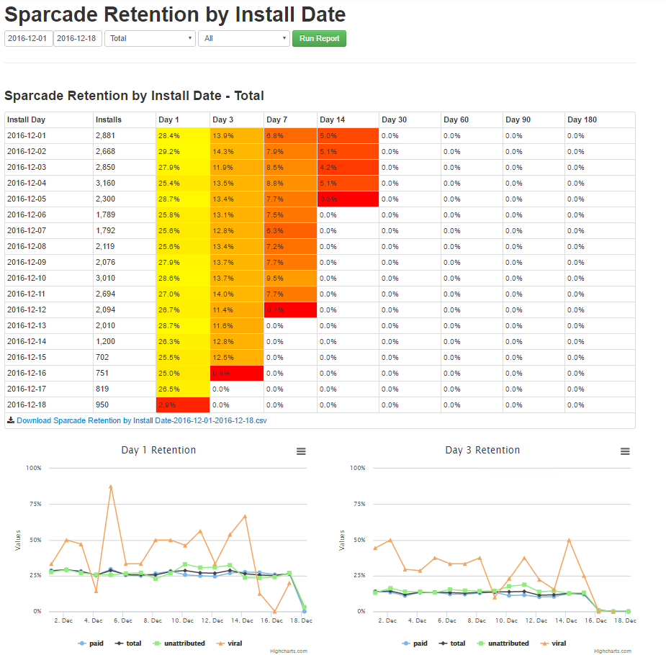

Slide 10
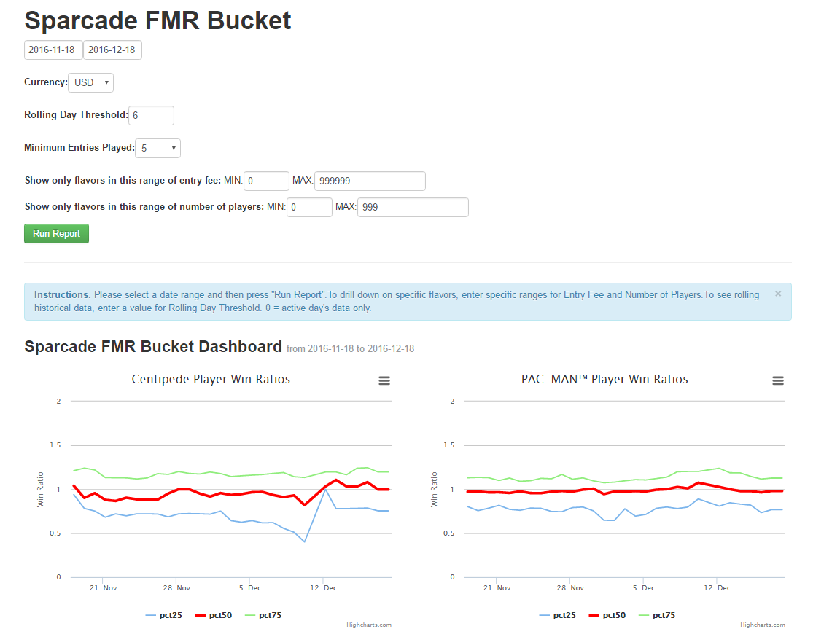

Slide 11
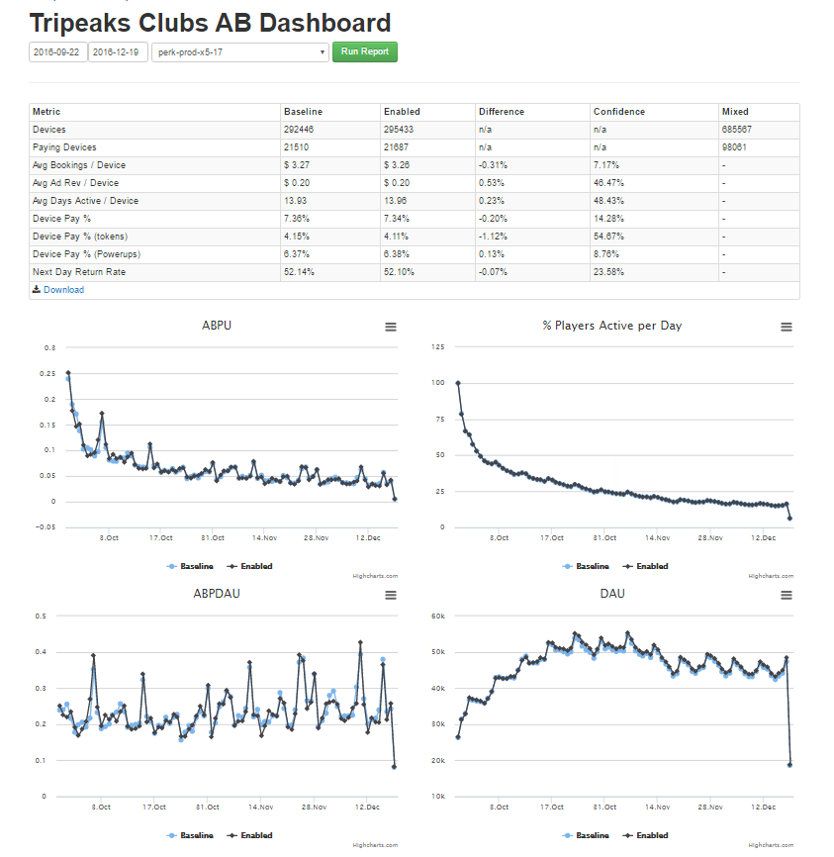
Tripeaks:-

Slide 12
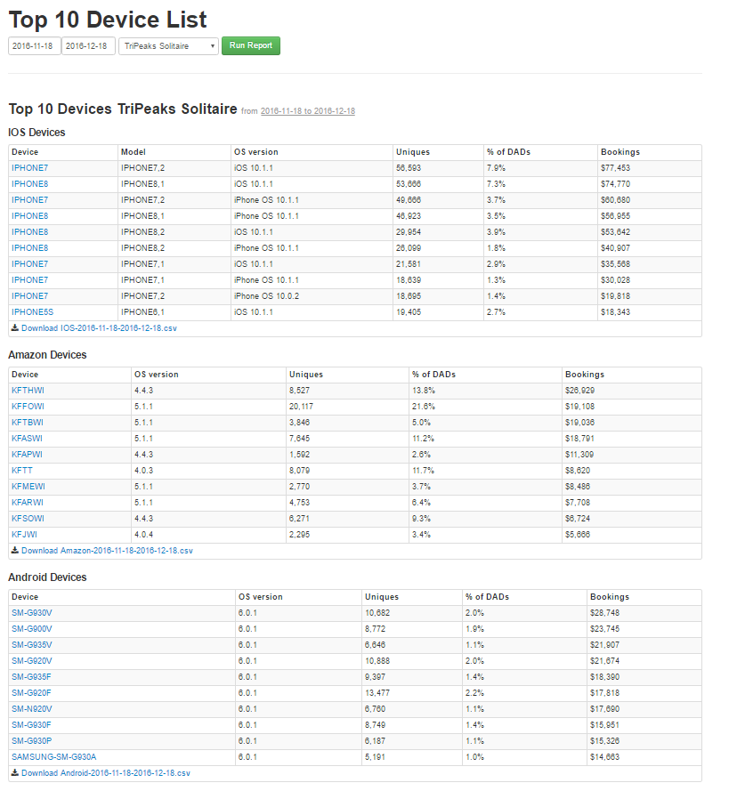
Platform Specific Report(Mobile):-

Slide 13
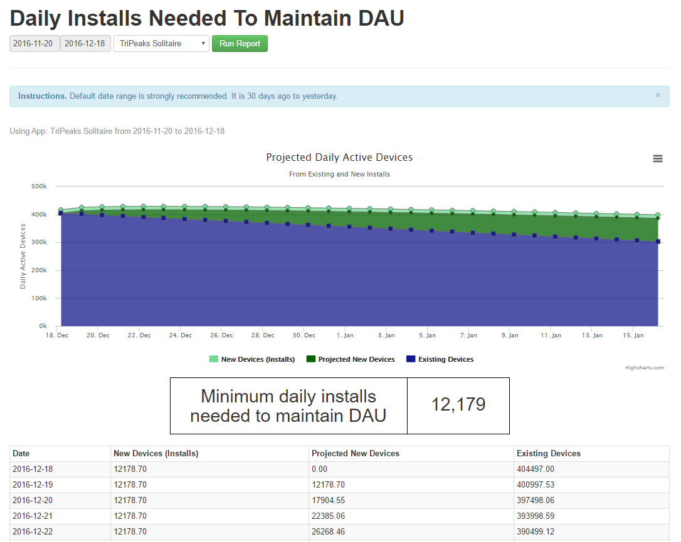

Slide 14
SqlIDE:-
Multiple forms submission fix
Updated bookmark link with query name
Date sorting fix
Zooming to charts
JSON mode to sqlide

Slide 15
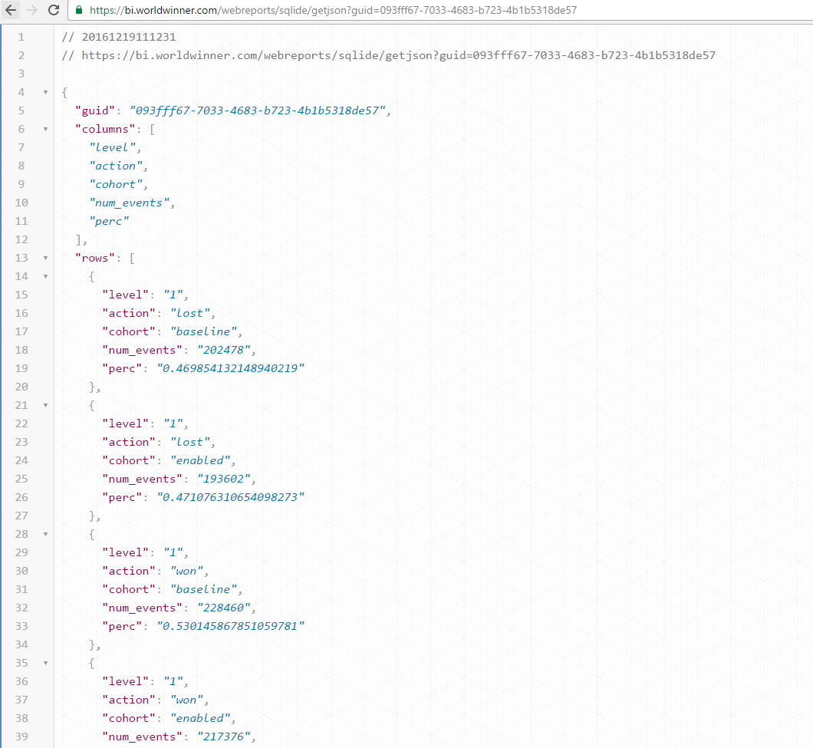
JSON Mode to SqlIDE:-

Slide 16
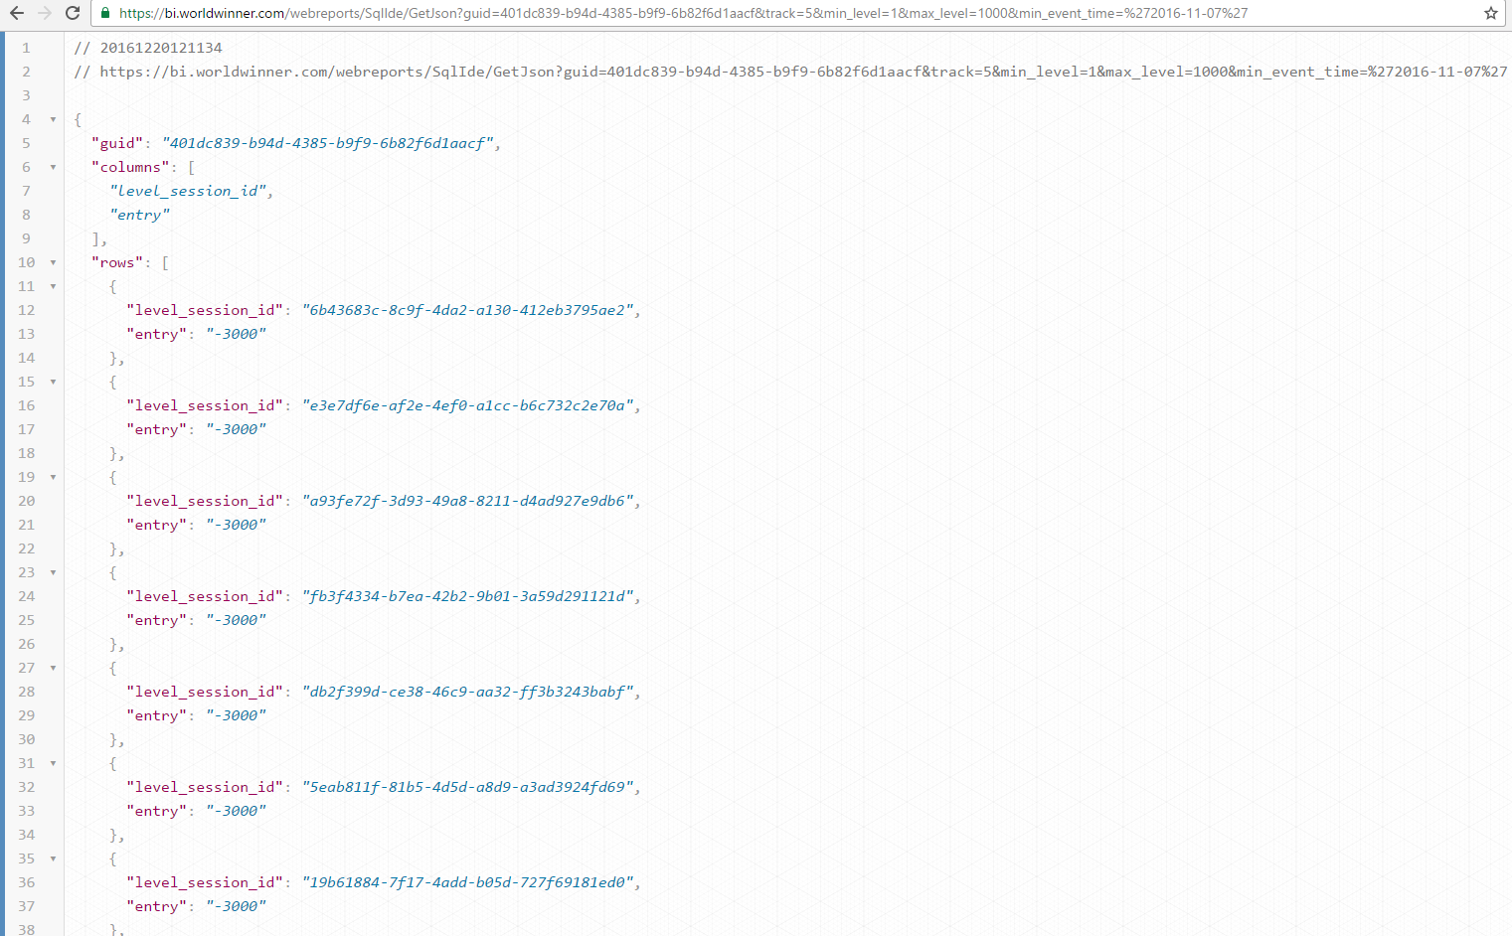

Slide 17
Learnings:-
JavaScript Libraries-moment,underscore,highcharts,datatables,numeral,handlebars,d3,jquery sparklines
Data Visualization tools-caravel,tableau10 trial
Vertica-analytical queries
Tutorials-
sql ,react.js,data visualization using Java
ASP.NET MVC architecture

Slide 18
Thank You!
- Privileged to be a part of The ‘Data Engineering’ Team!!

